Slide 1
大数据的处理框架： Hadoop MapReduce与PigLatin
清华大学
徐葳
本节部分内容翻译自 UC Berkeley “Great Ideas in Computer Architecture” 讲义
，Jeff Dean等人在SOSP 2004 关于MapReduce的讲稿，
Yahoo 研究院vChris Olston等人在SigMod 2008上关于Pig Latin的讲稿

Slide 2
本节课目标
数据并行
MapReduce编程模型
MapReduce的系统架构
MapReduce性能讨论
更高层的编程框架 – Pig Latin
Pig Latin语言
Pig Latin在Hadoop上的实现

Slide 3
数据类型与分析工具

Slide 4
数据并行

Slide 5
复习：GFS里几个重要的观点
数据存储于成百上千的服务器中
大数据块减少元数据的开销
使用商用硬件 -> 失败是很正常的
失败是不可避免的, 所以买便宜的硬件
没有复杂的一致性模型
单写者, 数据只能添加
避免互相等待

Slide 6
数据级并行化(DLP)
若干硬盘上的大量数据，可以被并行化的操作（比如，搜索文档）
“令人尴尬的并行”

Slide 7
例子: 词频统计
scan
that that is is that that is not is not is that it it is ……
GFS已经解决的问题
数据分块存储
that
is
not
并行?
全局状态

Slide 8
问题？
共享的状态
吞吐量（多个进程同时改变）
同步（同时修改需要锁）
小粒度的通信让元数据管理变得更复杂
失败的机器

Slide 9
例子：词频统计
局部个数
局部个数
局部个数
scan
that that is is that that is not is not is that it it is ……
并行?
that
is
not
全局状态

Slide 10
问题
共享的状态
吞吐量（多个进程同时改变）
同步（同时修改需要锁）
小粒度的通信让元数据管理变得更复杂
失败的机器
共享的状态太大？

Slide 11
例子：词频统计
局部个数
局部个数
局部个数
scan
that that is is that that is not is not is that it it is ……
that
is
not
分布式状态

Slide 12
问题
共享的状态
吞吐量（多个进程同时改变）
同步（同时修改需要锁）
小粒度的通信让元数据管理变得更复杂
失败的机器
共享的状态太大？
如果最终结果失败，重算？

Slide 13
其他问题
易用性
通用性
什么样的抽象？

Slide 14
Map Reduce 的编程模型

Slide 15
数据并行的分治策略 (MapReduce Processing)
映射（Map）:
将数据分割为“碎片”或者“裂片”，将它们分配给工作节点，工作节点来计算子问题的解。
化简（Reduce）:
收集，合并子问题的解
易于使用
开发者集中于问题
MapReduce系统解决细节

Slide 16
Map Reduce的基本编程模型
Map:
map(in_key,in_value)
->list(out_key,intermediate value)
处理输入的键值对
生成中间结果集
Reduce:
reduce(out_key,list(intermediate_value))
->list(out_value)
对于某个键，合并它所有的值
生成合并后的结果值集合

Slide 17
例子：词频统计
分发
that that is is that that is not is not is that it it is
Map 1
Map 2
Map 3
Map 4
that 2, is 1
is 1, that 2
is 2, not 2
is 2, it 2, that 1
洗牌
is 1
is 1,1
that 2
that 2,2
is 1,1,2,2
it 2
that 2,2,1
not 2
Reduce 1
Reduce 2
is 6; it 2
not 2; that 5
收集
is 6; it 2; not 2; that 5

Slide 18
例子:词频统计
Reduce过程对于某个单词对应的所有次数进行求和
map(String input_key, String input_value):
// input_key: document name
// input_value: document contents
localCount = CountLocally(input_value);
for each count:
Emit (word, count); // Produce count of words
reduce(String word, Iterator intermediate_values):
// word: the word (in the intermediate key);
// intermediate_values: a list of counts
int result = 0;
for each v in intermediate_values:
result += v;
Emit(word, result);

Slide 19
种类比较
map (k1,v1) ➔ list(k2,v2)
reduce (k2,list(v2)) ➔ list(v2)
输入的键和值，与输出的键和值相比，属于不同的区域
中间结果中的键和值，与输出的键和值相比，属于相同的区域

Slide 20
MAP reduce执行过程

Slide 21
执行步骤
Map函数，通过将输入数据分割成M块，来被分布式地调用
通常每个数据块16MB或者64MB
取决于GFS的数据块大小
输入数据由不同的服务器来并行的处理
Reduce函数，通过将中间结果分割成R块，来被分布式地调用
用户挑选的数字应满足 M >> # servers, R > # servers
很大的M值能够有助于负载均衡，以及从失败中恢复
每R个调用，对应一个输出文件，所以R值不应该太大

Slide 22
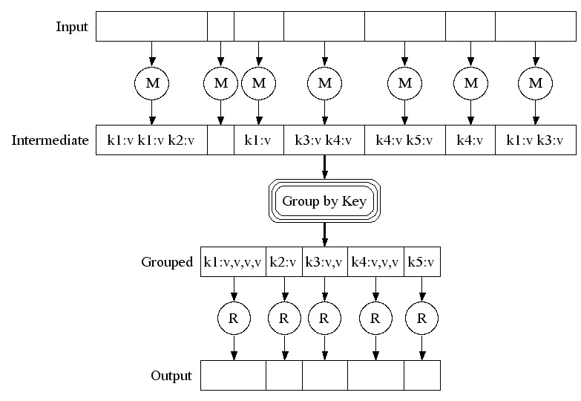
MapReduce 执行过程
细粒度任务：map任务的个数远大于机器个数
桶排序，使得同样的键对放在一起
2000 服务器=> ≈ 200,000 Map任务,
≈ 5,000 Reduce任务

Slide 23
洗牌过程 (通过key来分组)
Map 1
emit(key, value)
Map 2
emit(key, value)
Partition function
# of Shards = # of reduce
shard_id = partition(key)
shard_id = partition(key)
Shard 1
Shard 2
Shard 3
…….
Shard 1
Shard 2
Shard 3
…….
that : 2
this : 2
is : 2
he : 66
this : 11
is : 33
me : 2
he : 1
that : 4
Remote Read
Reduce 1
Reduce 2
Reduce 3
Shard 1
Shard 1
Shard 2
Shard 2
that : 2
he : 66
this : 2
this : 11
he : 1
that : 4
Sort
that : 2, 4 ….
he: 1, 66 ….
this : 2, 11 ….

Slide 24
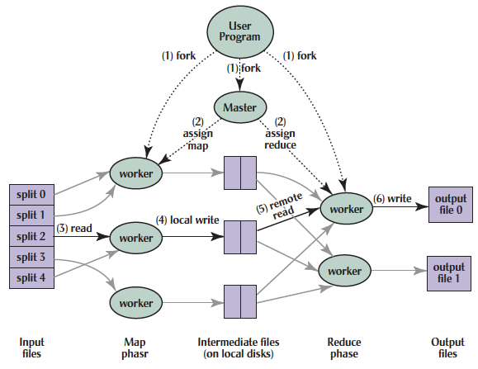
MapReduce Processing
Shuffle phase
Notes:
1. MR 1st splits the input files into M “splits” then starts many copies of
program on servers

Slide 25
MapReduce Processing
Shuffle phase
Notes:
2. One copy—the master— is special. The rest
are workers. The master picks idle workers and
assigns each 1 of M map tasks or 1 of R reduce tasks.
We subdivide the map phase into M pieces and the reduce phase into R pieces as described previously. Ideally, M and R should be much larger than the number of worker machines. Having each worker perform many different tasks improves dynamic load balancing and also speeds up recovery when a worker fails: the many map tasks it has completed can be spread out across all the other worker machines. There are practical bounds on how large M and R can be in our implementation since the master must make O(M+R) scheduling decisions and keep O(M*R) state in memory as described. (The constant factors for memory usage are small, however. The O(M*R) piece of the state consists of approximately one byte of data per map task/reduce task pair.) Furthermore, R is often constrained by users because the output of each reduce task ends up in a separate output file. In practice, we tend to choose M so that each individual task is roughly 16MB to 64MB of input data (so that the locality optimization described previously is most effective), and we make R a small multiple of the number of worker machines we expect to use. We often perform MapReduce computations with M=200,000 and R=5,000, using 2,000 worker machines.

Slide 26
MapReduce Processing
Shuffle phase
Notes:
3. A map worker reads the input split. It parses key/value pairs of the input data and passes each pair to the user-defined map function.
(The intermediate
key/value pairs produced by the map function are buffered in memory.)

Slide 27
MapReduce Processing
Shuffle phase
Notes:
4. Periodically, the buffered pairs are written to local disk, partitioned
into R regions by the partitioning function.
The locations of these buffered pairs on the local disk are passed back to the master who is responsible for forwarding these locations to the reduce workers.

Slide 28
MapReduce Processing
Shuffle phase
Notes:
5. When a reduce worker has read all intermediate data for its partition, it bucket sorts using inter-mediate keys so that occur-rences of same keys are grouped together
(The sorting is needed because typically many different keys map to
the same reduce task )

Slide 29
MapReduce Processing
Shuffle phase
Notes:
6. Reduce worker iterates over sorted intermediate data and for each unique intermediate key, it passes key and corresponding set of values to the user’s reduce function.
The output of the reduce function is appended to a final output file for this reduce partition.

Slide 30
MapReduce Processing
Shuffle phase
Notes:
7. When all map tasks and reduce tasks have been completed, the master
wakes up the user program. The MapReduce call
in user program returns back to user code.
Output of MR is in R output files (1 per reduce task, with file names specified by user); often passed into another MR job so don’t combine

Slide 31
Map reduce执行过程演示

Slide 32
（这段重新根据新版的hadoop截屏做一下）

Slide 33
展示MapReduce任务运行
一共41分钟
29分钟用于Map任务以及洗牌任务
12分钟用于Reduce任务
一共使用了1707个工作服务器
Map (Green) 任务 读0.8 TB, 写0.5 TB
Shuffle (Red) 任务 读0.5 TB, 写0.5 TB
Reduce (Blue) 任务 读0.5 TB, 写0.5 TB

Slide 34
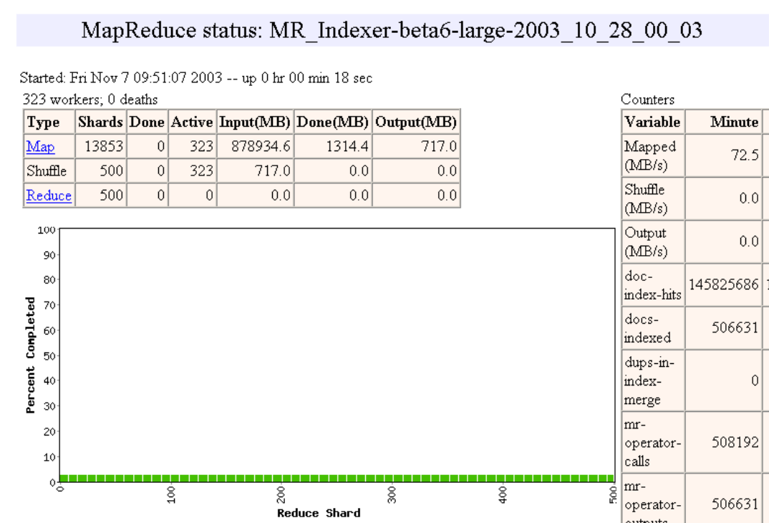

Slide 35
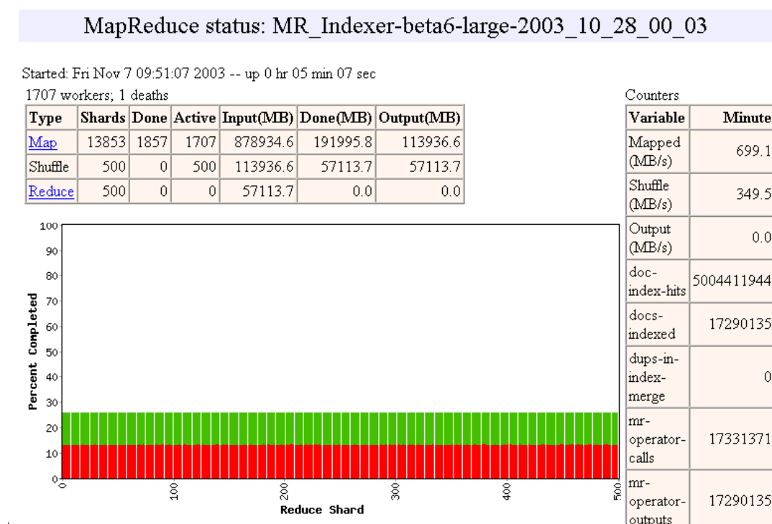

Slide 36
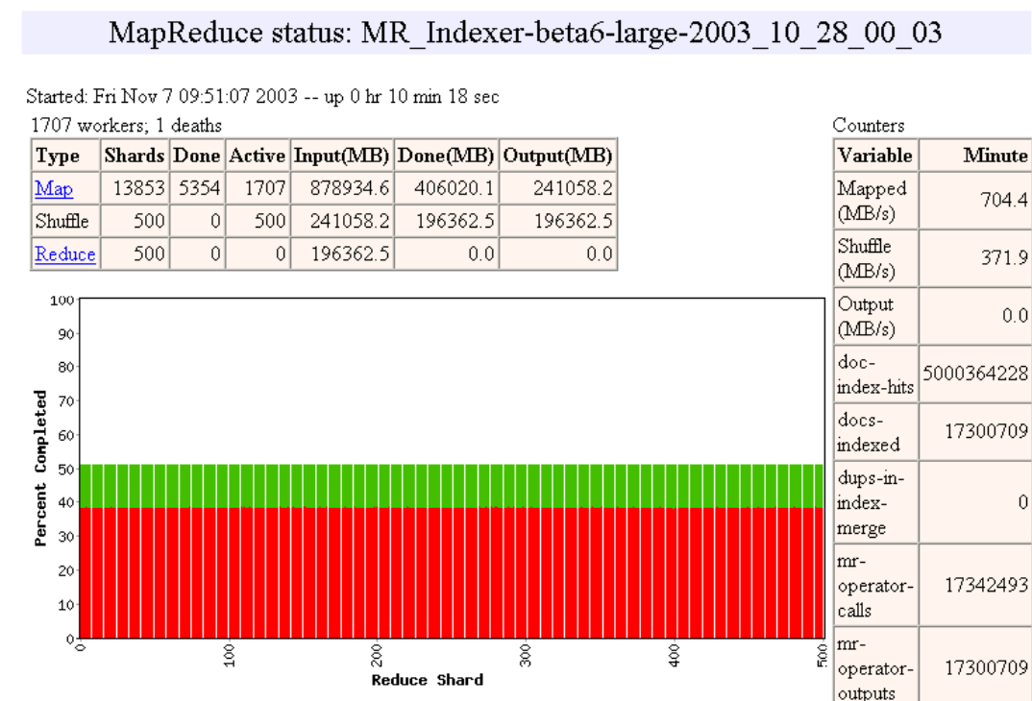

Slide 37
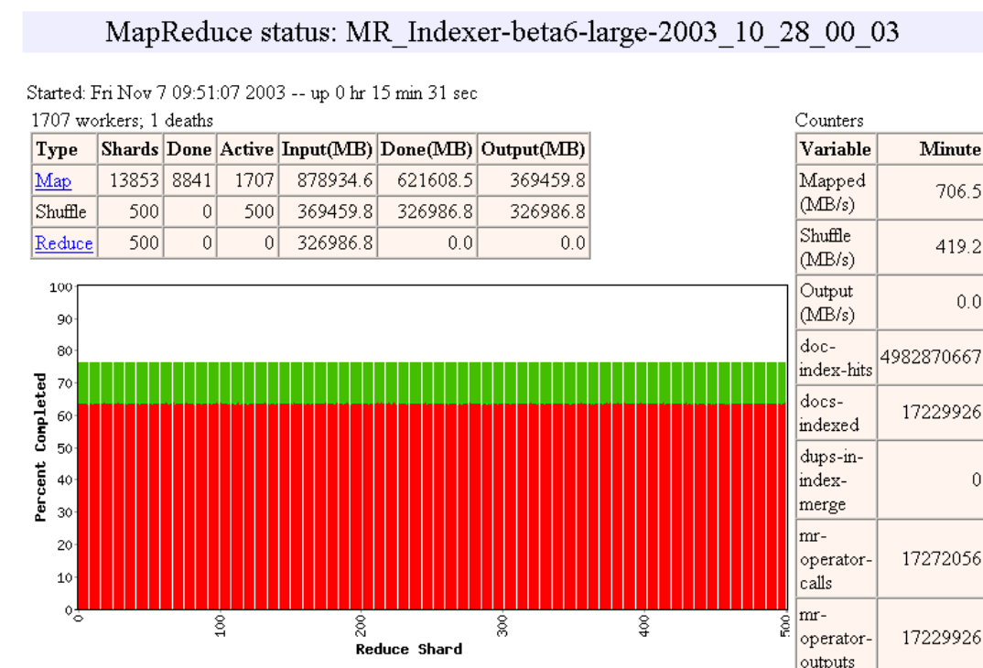

Slide 38
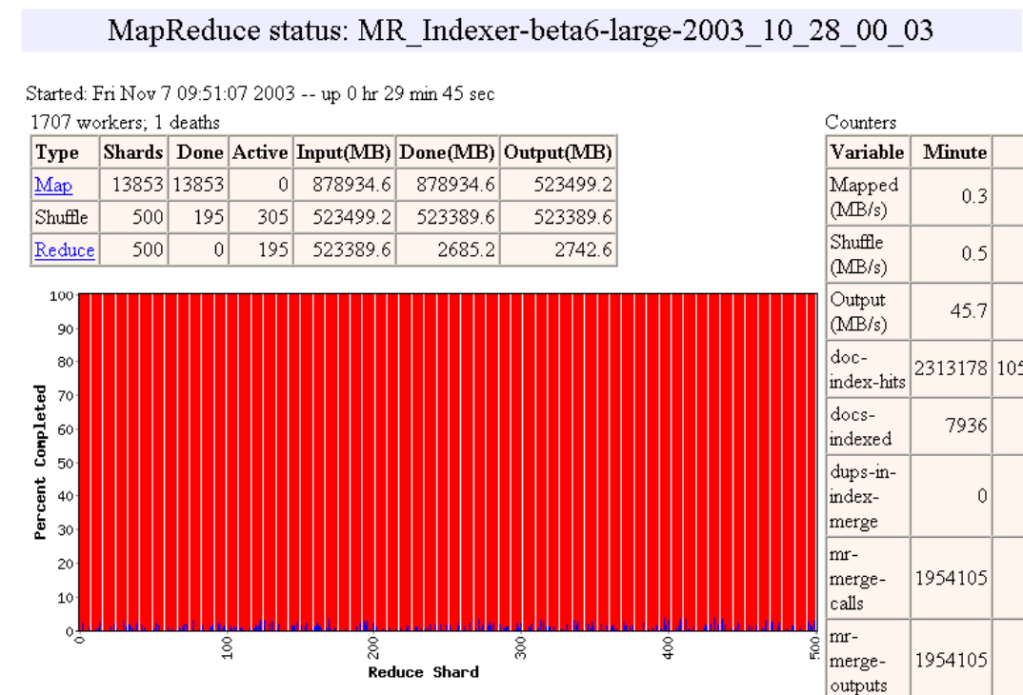

Slide 39
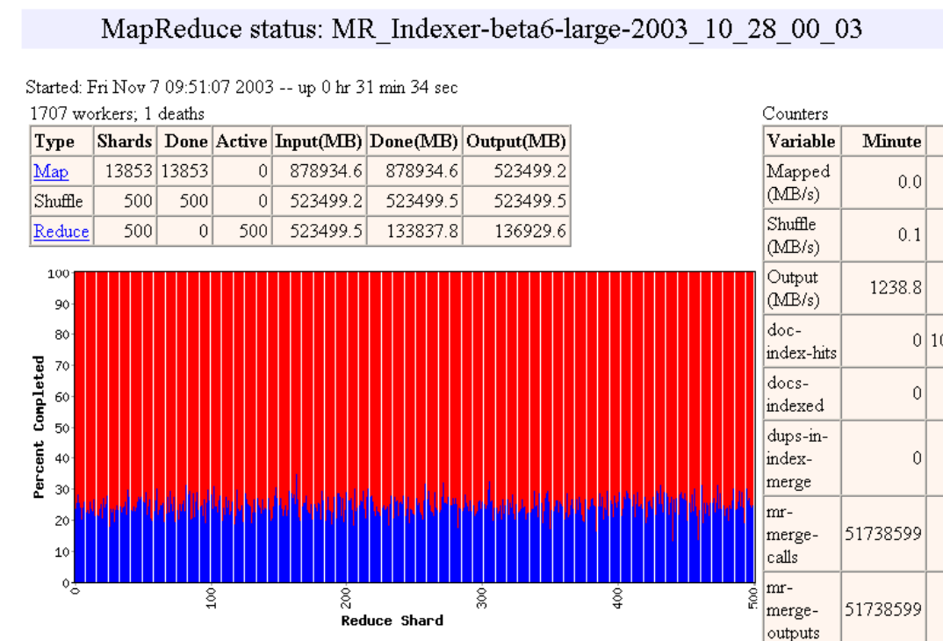

Slide 40
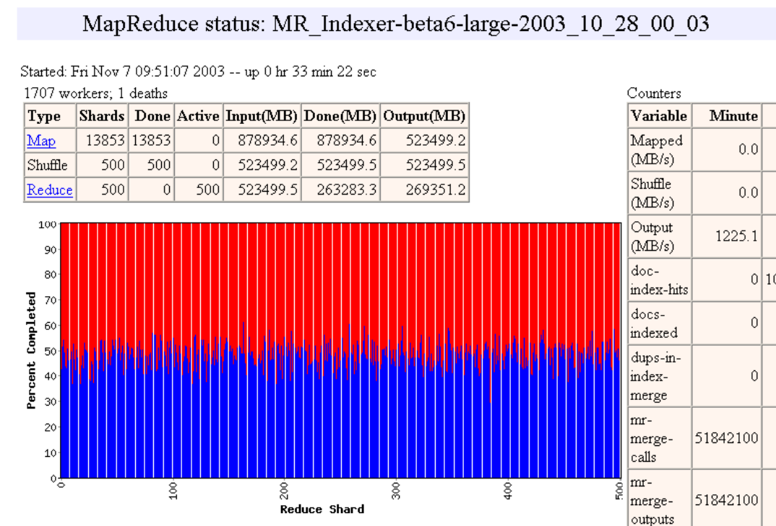

Slide 41
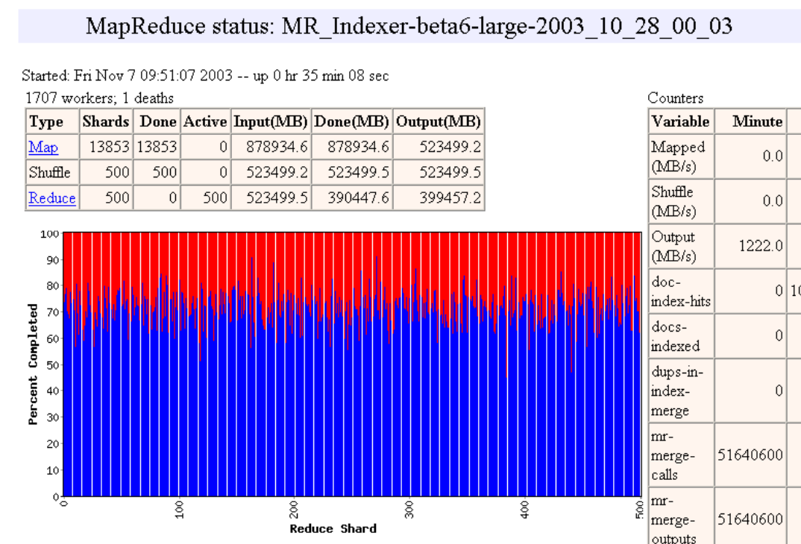

Slide 42
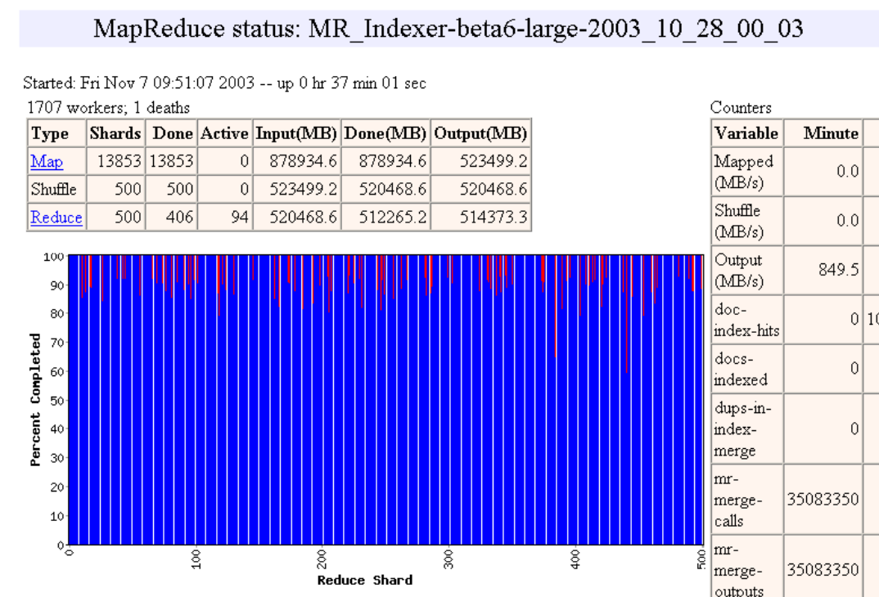

Slide 43


Slide 44


Slide 45
Map reduce一些性能优化讨论

Slide 46
MapReduce冗余执行
Independent
慢的工作节点极大地延长完成时间
解决方案：在接近结束时，生成任务的备份
谁最先完成，谁“获胜”
影响：极大地缩短任务完成时间
资源增加3%，大型任务速度提高30%
Idempotent

Slide 47
MapReduc故障处理
工作节点故障：
控制节点通过周期性的心跳来检测故障
重新执行
控制节点故障：
可以解决，但是目前还没有解决（控制节点故障可能性很低）
健壮性：曾经丢失1800个节点中的1600个，但是任务仍然完成了。

Slide 48
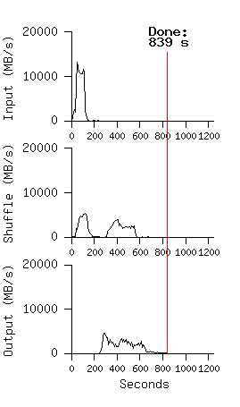
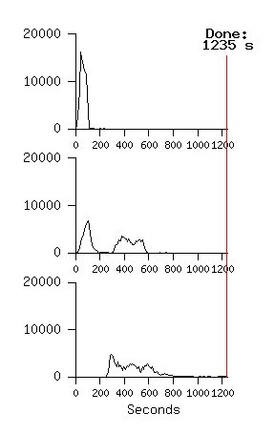
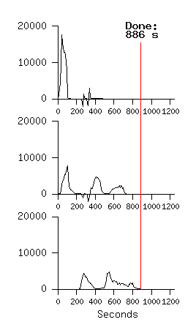
重启执行过程的影响，使用1800个服务器进行10B记录排序的故障
No Backup Tasks
(44% Longer)
Kill 200 workers
(5% Longer)
Notes:
Figure 3 (a) shows the progress of a normal execution of the sort program.
The top-left graph shows the rate at which input is read. The rate peaks at about 13 GB/s and dies off fairly quickly since all map tasks finish before 200 seconds have elapsed.
The middle-left graph shows the rate at which data is sent over the network from the map tasks to the reduce tasks. This shuffling starts as soon as the first map task completes. The first hump in the graph is for the first batch of approximately 1700 reduce tasks (the entire MapReduce was assigned about 1700 machines, and each machine executes at most one reduce task at a time). Roughly 300 seconds into the computation, some of these first batch of reduce tasks finish and we start shuffling data for the remaining reduce tasks. All of the shuffling is done about 600 seconds into the computation.
The bottom-left graph shows the rate at which sorted data is written to the final output files by the reduce tasks. There is a delay between the end of the first shuffling period and the start of the writing period because the machines are busy sorting the intermediate data. The writes continue at a rate of about 2-4 GB/s for a while. All of the writes finish about 850 seconds into the computation.
Including startup overhead, the entire computation takes 891 seconds.
A few things to note: the input rate is higher than the shuffle rate and the output rate because of our locality optimization – most data is read from a local disk and bypasses our relatively bandwidth constrained network.
The shuffle rate is higher than the output rate because the output phase writes two copies of the sorted data (we make two replicas of the output for reliability and avail- ability reasons). We write two replicas because that is the mechanism for reliability and availability provided by our underlying file system.
In Figure 3 (b)[middle], we show an execution of the sort pro- gram with backup tasks disabled. The execution flow is similar to that shown in Figure 3 (a), except that there is a very long tail where hardly any write activity occurs. After 960 seconds, all except 5 of the reduce tasks are completed. However these last few stragglers don’t fin- ish until 300 seconds later. The entire computation takes 1283 seconds, an increase of 44% in elapsed time.
In Figure 3 (c)[right], we show an execution of the sort program where we intentionally killed 200 out of 1746 worker processes several minutes into the computation. The underlying cluster scheduler immediately restarted new worker processes on these machines (since only the pro- cesses were killed, the machines were still functioning properly).The worker deaths show up as a negative input rate since some previously completed map work disappears (since the corresponding map workers were killed) and needs to be redone. The re-execution of this map work happens relatively quickly. The entire computation fin- ishes in 933 seconds including startup overhead (just an increase of 5% over the normal execution time).

Slide 49
Hadoop：map reduce的开源实现

Slide 50
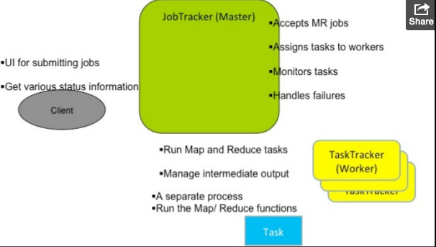
Hadoop Mapreduce的基本架构

Slide 51
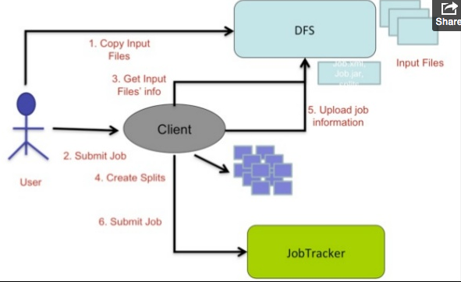
Hadoop MR程序执行过程1

Slide 52
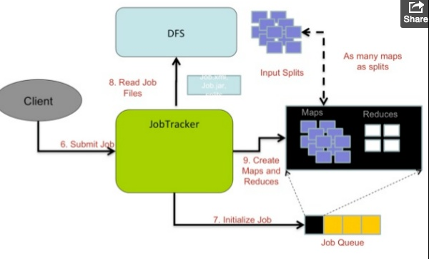
Hadoop程序执行过程2

Slide 53
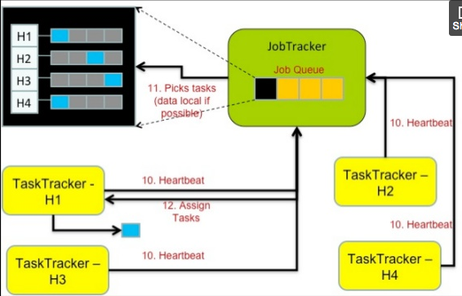
Hadoop 执行过程 3

Slide 54
Map reduce总结

Slide 55
MapReduce理解要点
严格的键值对模型
同样细粒度的操作（Map & Reduce）重复作用于大数据
操作必须是确定的
操作必须是幂等的/没有副作用的
只有洗牌过程中才有通信
操作（Map & Reduce）的输出存储于硬盘上

Slide 56
MapReduce用来做什么？
Google:
为Google Search建立索引
为Google News进行文章聚类
统计性的机器翻译
Yahoo!:
为Yahoo！Search建立索引
为Yahoo！Mail进行垃圾检测
Facebook:
数据挖掘
广告优化
垃圾检测

Slide 57
MapReduce优点
分布式过程完全透明
没有一行的分布式编程（既方便，又保证正确性）
自动的容错性
操作的确定性保证了故障的任务可以在其他地方再次运行
保存的中间结果保证了只需要重新运行故障的reduce节点
自动的规模缩放
由于操作是没有副作用的，所以它们可以动态地被分发到任何数量的机器
自动的负载均衡
及时移动任务，投机性地执行慢的任务（称为stragglers）)
Notes:
Transparent: not a single line of code

Slide 58
MapReduce缺点
1. 极其严格的数据流
M
R
其他流持续的加入
M
M
R
M
Join, Union
Split
Chains
2. 常见的操作必须手写代码
比如 Join, filter, projection, aggregates, sorting, distinct
3. 语义隐藏在map-reduce函数中
维护，扩展，优化都比较困难

Slide 59
Pig latin语言简介

Slide 60
示例数据分析任务
找出每个类型中前十个最常访问的页面
用户访问
Url 信息
用户 | Url | 时间
Amy | cnn.com | 8:00
Amy | bbc.com | 10:00
Amy | flickr.com | 10:05
Fred | cnn.com | 12:00
Url | 类型 | PageRank
cnn.com | News | 0.9
bbc.com | News | 0.8
flickr.com | Photos | 0.7
espn.com | Sports | 0.9

Slide 61
数据流
Load Visits
Group by url
Foreach url
generate count
Load Url Info
Join on url
Group by category
Foreach category
generate top10 urls

Slide 62
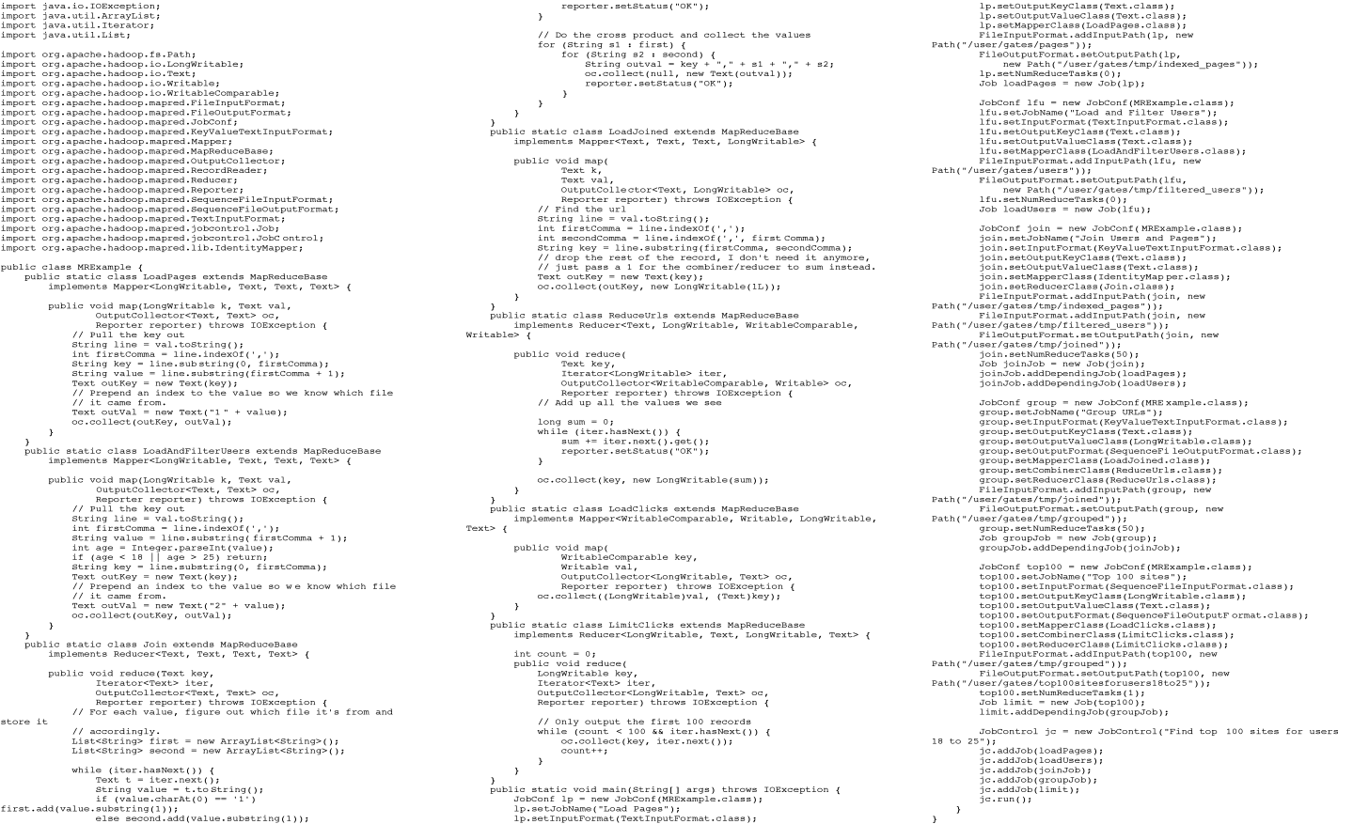
MapReduce代码
Example from http://wiki.apache.org/pig-data/attachments/PigTalksPapers/attachments/ApacheConEurope09.ppt
Notes:
My point in putting in the java code isn’t too actually walk through it. It’s just to show that you have to hand code a fair amount of java. That way I can just point and say “look how much java you’d have to write to accomplish this”

Slide 63

Apache Pig
高级编程语言:
快速的MapReduce工作序列
提供关系型数据库操作（例如JOIN，GROUP BY）
易于嵌入Java函数
最先应用于Yahoo! Research
运行Yahoo！大约50%的任务
https://pig.apache.org/

Slide 64
Pig Latin代码
visits = load ‘/data/visits’ as (user, url, time);
gVisits = group visits by url;
visitCounts = foreach gVisits generate url, count(visits);
urlInfo = load ‘/data/urlInfo’ as (url, category, pRank);
visitCounts = join visitCounts by url, urlInfo by url;
gCategories = group visitCounts by category;
topUrls = foreach gCategories generate top(visitCounts,10);
store topUrls into ‘/data/topUrls’;

Slide 65
快速入门与互操作性
visits = load ‘/data/visits’ as (user, url, time);
gVisits = group visits by url;
visitCounts = foreach gVisits generate url, count(urlVisits);
urlInfo = load ‘/data/urlInfo’ as (url, category, pRank);
visitCounts = join visitCounts by url, urlInfo by url;
gCategories = group visitCounts by category;
topUrls = foreach gCategories generate top(visitCounts,10);
store topUrls into ‘/data/topUrls’;
操作直接作用于文件

Slide 66
快速入门与互操作性
visits = load ‘/data/visits’ as (user, url, time);
gVisits = group visits by url;
visitCounts = foreach gVisits generate url, count(urlVisits);
urlInfo = load ‘/data/urlInfo’ as (url, category, pRank);
visitCounts = join visitCounts by url, urlInfo by url;
gCategories = group visitCounts by category;
topUrls = foreach gCategories generate top(visitCounts,10);
store topUrls into ‘/data/topUrls’;
模式是可选的；可被动态的赋值

Slide 67
用户代码是一等公民
visits = load ‘/data/visits’ as (user, url, time);
gVisits = group visits by url;
visitCounts = foreach gVisits generate url, count(urlVisits);
urlInfo = load ‘/data/urlInfo’ as (url, category, pRank);
visitCounts = join visitCounts by url, urlInfo by url;
gCategories = group visitCounts by category;
topUrls = foreach gCategories generate top(visitCounts,10);
store topUrls into ‘/data/topUrls’;
用户定义函数 (UDFs)可以使用于任何构造过程
Load, Store
Group, Filter, Foreach

Slide 68
嵌套的数据结构

Slide 69
嵌套数据模型
Pig Latin具备完全可嵌套的数据模型，诸如：
原子值（Atomic Values），元组（tuples），包（列表）（bags（lists）），映射（maps）
对开发者来说，比平元组（flat tuples）更自然
避免代价昂贵的joins操作
finance
yahoo ,
email
news

Slide 70
嵌套数据模型
解耦grouping操作作为一个独立的操作
User | Url | Time
Amy | cnn.com | 8:00
Amy | bbc.com | 10:00
Amy | bbc.com | 10:05
Fred | cnn.com | 12:00
group | Visits
cnn.com | Amy | cnn.com | 8:00
 | Fred | cnn.com | 12:00
bbc.com | Amy | bbc.com | 10:00
 | Amy | bbc.com | 10:05
group by url

Slide 71
共同分组（CoGroup）
results
revenue
query | url | rank
Lakers | nba.com | 1
Lakers | espn.com | 2
Kings | nhl.com | 1
Kings | nba.com | 2
query | adSlot | amount
Lakers | top | 50
Lakers | side | 20
Kings | top | 30
Kings | side | 10
group | results |  |  | revenue
Lakers | Lakers | nba.com | 1 | Lakers | top | 50
 | Lakers | espn.com | 2 | Lakers | side | 20
Kings | Kings | nhl.com | 1 | Kings | top | 30
 | Kings | nba.com | 2 | Kings | side | 10
两个包的叉积相当于自然连接（natural join）

Slide 72
Pig latin的实现和优化

Slide 73

实现
SQL
user
自动重写
+优化
Pig
or
or
Hadoop Map-Reduce
cluster
~50%的Yahoo！的Hadoop
任务是Pig
每天1000多个任务

Slide 74
编译嵌入MapReduce
Map₁
每一个group或join操作形成一个mapreduce边界
Load Visits
Group by url
Reduce₁
Map₂
Foreach url
generate count
Load Url Info
Join on url
Reduce₂
Map₃
其他操作进入map和reduce阶段的流水线
Group by category
Reduce₃
Foreach category
generate top10(urls)

Slide 75
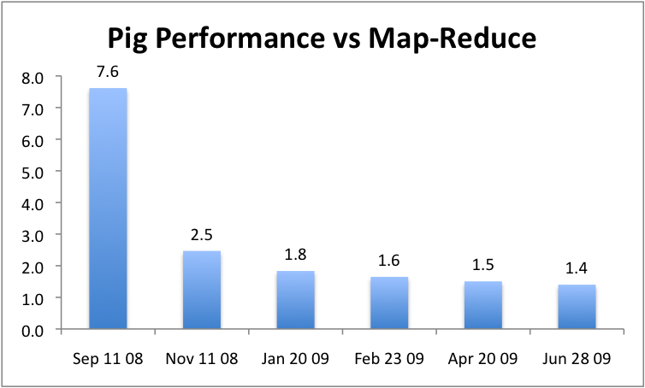
抽象的优势
可以逐渐优化，不影响用户使用

Slide 76
优化:合并函数（Combiner）
Input
records
k₁ | v₁
k₂ | v₂
k₁ | v₃
k₁ | v₁
k₁ | v₃
k₁ | v₅
Output
records
map
reduce
map
k₂ | v₄
k₁ | v₅
k₂ | v₂
k₂ | v₄
reduce
可以在map端预处理数据，来减少数据的传输
代数聚合函数
独特处理

Slide 77
优化: 斜交连接（Skew Join）
如果很多值都有同样的键的话，就会有问题
Skew join对数据进行采样，来找到高频值
在reducer中进一步的分割他们
group | results |  |  | revenue
Lakers | Lakers | nba.com | 1 | Lakers | top | 50
 | Lakers | espn.com | 2 | Lakers | side | 20
Kings | Kings | nhl.com | 1 | Kings | top | 30
 | Kings | nba.com | 2 | Kings | side | 10

Slide 78
优化:碎片复制连接（Fragment-Replicate Join）
对称哈希连接，对输入数据重分割
如果size(data set 1) >> size(data set 2)
复制数据集2到数据集1的分片中
转化为map-only的任务
打开数据集2为“slide file”

Slide 79
优化: 多数据流
Load Users
Map₁
Filter bots
Group by
state
Group by
demographic
Reduce₁
Apply udfs
Apply udfs
Store into ‘bystate’
Store into ‘bydemo’

Slide 80
优化: 多数据流
Load Users
Map₁
Filter bots
Split
Group by
state
Group by
demographic
Demultiplex
Reduce₁
Apply udfs
Apply udfs
Store into ‘bystate’
Store into ‘bydemo’

Slide 81
其他类似框架
Sawzall
基于MapReduce的数据处理语言
在聚合之后，严格的过滤结构
Hive
基于MapReduce的类似SQL的语言
DryadLINQ
基于Dryad的类似SQL的语言

Slide 82
总结与课程之后的内容展望

Slide 83
Hadoop与Pig

Slide 84
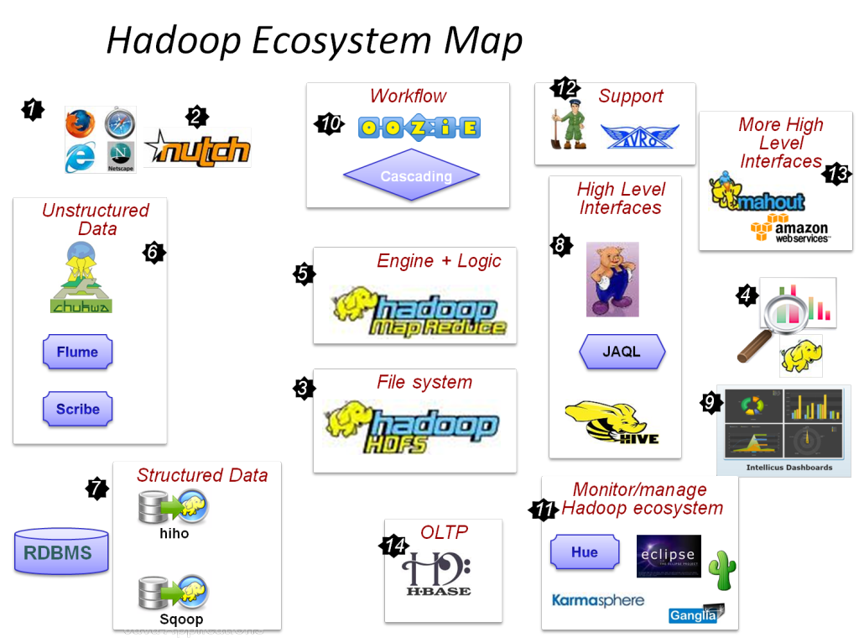
Hadoop 生态系统

Slide 85
另一面: “MapReduce: A major step backwards”
David J. DeWitt， Michael Stonebraker
在编程模式中后退了一大步
没有模式，没有高级的访问语言
一个次优化的实现
它使用了暴力法而不是索引
一点也不创新
25年前就有类似的技术
缺少了目前数据库管理系统一般都有的大多数特点
索引，更新，事务，完整性约束，逻辑视图

